Slide 1
GS CAPSULE
Glorious health for all Successful life for all

Slide 2
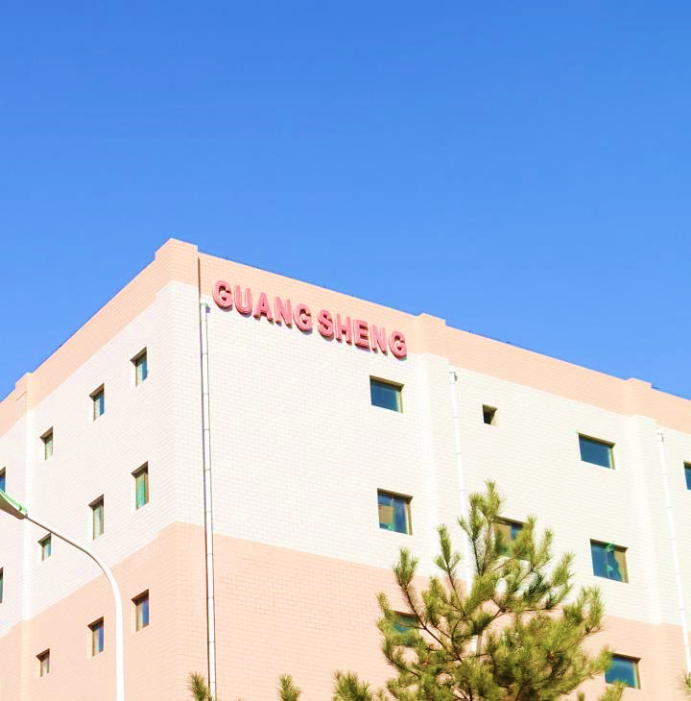
Overview
公司简介
GS Capsule was established in 1983 with over forty years capsule expertise, as a premier global empty hard capsule leader producing Gelatin, HPMC, Pullulan, and Enteric capsules.
We offer 14 different capsule sizes ranging from 000# to 5, elongated sizes and broad colors, as well as customized solutions.
In 2021, Advent successfully acquired GS Capsule.
Pioneer Capsule Manufacturer in China
GMP, NSF, BRC, ISO9001, ISO1400, ISO45001, Halal, Kosher, DMF certified
广生胶囊成立于1983年，是中国本土历史最悠久、产能最大的胶囊生产商。品种主要包括明胶胶囊、羟丙甲纤维素胶囊、普鲁兰多糖胶囊、肠溶明胶胶囊等。广生目前拥有全自动胶囊生产线96条，年产能480亿粒；规格型号达十四种，亦是业内品类规格最全的企业之一。2021年12月，全球最大且最富经验的私募股权投资基金之一——安宏资本完成收购广生胶囊的多数股权
Gelatin capsule, HPMC capsule, Pullulan capsule and Enteric capsule
96 automatic production lines with 48 billion capsules capacity
Technical support available and on-site problem solving
Everything you need to fulfill your diverse range of capsule requirements

Slide 3
Key Milestones
Pioneer of capsule automatic production line in China
Awarded Certificate of National high quality role model
Introduced enteric capsule automatic production line
Advent acquired majority equity
1983
1991
1998
2008
2013
2016
2017
2021
2023
Introduced production of Medicinal Empty capsules
Introduced Canada TES automatic production line
Introduced HPMC capsule automatic production line
NO.1 CNAS laboratory in China capsule industry
Achieve 96 automatic production lines yielding 48 billion capsules
GS Capsule Europe
GS Capsule America
GS Capsule China
Europe
Asia
Africa
North America
South America
Australia

Slide 4
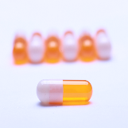
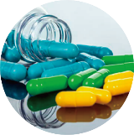
Product Portfolio
Gelatin Capsule
HPMC Capsule
Pullulan Capsule
Enteric Capsule
Full range sizes
Color match services
Halal Certification Available
Widely used in pharmaceuticals and dietary supplements
Low moisture content
Vegan
Perfect option for moisture sensitive ingredients
Machinability 99.9%
Vegan, natural
Crystal clear appearance
Cross- linking free
Low oxygen permeability, extend shelf life
Dissolve only in intestine juice
Fully automatic production environment, superior microbe control
Easier and more convenient way to develop a modified-release product

Slide 5
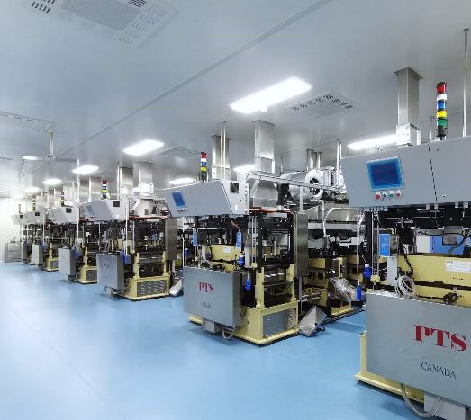
The largest Capsule manufacturer in China
1000+ Clients
96 Automatic production lines
40 Year History
48 Billion Capacity

Slide 6
Certificates
ISO9001
ISO14001
GMP compliance
EtO disinfection free
Titanium dioxide free formulation available
Certified raw materials
FDA Active Type IV DMF
Able to help meet different regional needs and dietary preferences
Halal
Kosher
US NSF
UK BRC

Slide 7
ETO Free
The European Agency for the Evaluation of Medicinal Products Evaluation of Medicines for Human Use
EU Regulation: Ethylene oxide: 0.01PPM
Our Full-automatic production lines in sterile environment
with high quality sourced raw materials and superior process control enables ETO free

Slide 8
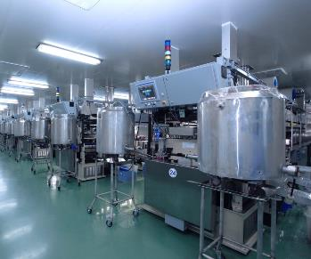
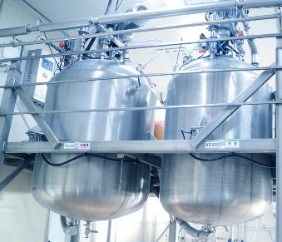
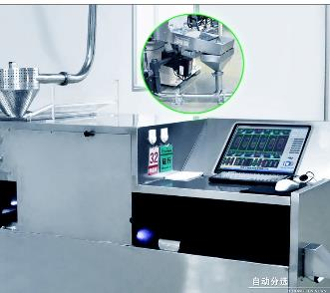
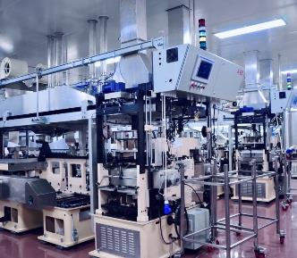
Fully automatic production to ensure quality consistency
Production
Production
24-hour monitoring
Precise control
Inspection
Real-time detection
Full-automatic production line Less manual

Slide 9
Zero Microbial Risk
Our Commitment
Your Safety
Raw materials Sourcing control
Environment & Purified water Detection
Instrument/equipment surface colony control
Semi-finished product Detection
End product Detection

Slide 10
Customised Solution
Full size coverage including 000#, 00#, 0#, 1#, 2#, 3#, 4#, 5#, as well as safe type
Customizable offerings in color, print, etc requirements
Extensive know-how brings superior color compliance and capabilities
Titanium dioxide free formulation available
ETO Free available

Slide 11
Customized Printing
Wide range of options to enhance Brand Security & Differentiation
Enhance Brand Visibility
Customized printing of graphic, logo or text on capsules
Printing process
Provides effective protection against counterfeiting
Intricate and secured printing technology
Ink Control:Confirm label before use
Steel wheel control: Usage records
Blade control: requisition and recycling
Visual inspection
Document confirmation: cargo card confirmed
Equipment cleaning and site clearance
Unique way to achieve effective brand differentiation
Our solution enables attractive printing using up to
all colors
Intricate way to prevent counterfeiting of capsules
One-stop solution from customized designing to supply of pre-printed capsules

Slide 12
About Advent
全球
投资
Founded in 1984, Advent International is one of the largest and most experienced global private equity investors, with a strong presence in North America, South America, Western Europe, Eastern Europe and Asia. Advent International has more than 250 investment professionals in 15 offices.
Global
Investment
成功
经验
Advent has invested in 400+ companies in 42 countries around the world. Advent International has $90+ billion assets under management and successfully raised the tenth Global Fund GPE X with a fund size of $25 billion for global investments.
Advent International
is a global private equity firm with a long history of almost 40 years.
Successful Experience
Advent invests in well-positioned companies with operational and strategic improvement potential. They have successfully partnered with management teams to create sustainable value through revenue and earnings growth, for nearly four decades. More than 70 experts from various industries have formed Advent’s senior strategic consultant team.
价值
创造
Value Creation
中国
使命
Three main goals: Invest in outstanding Chinese companies and further create value for the companies, help global portfolio companies develop China strategies, and support the global team to invest in companies with China angles.
Focused sectors: Healthcare; Retail, Consumer & Leisure; Business & Financial Services
China Mission

Slide 14
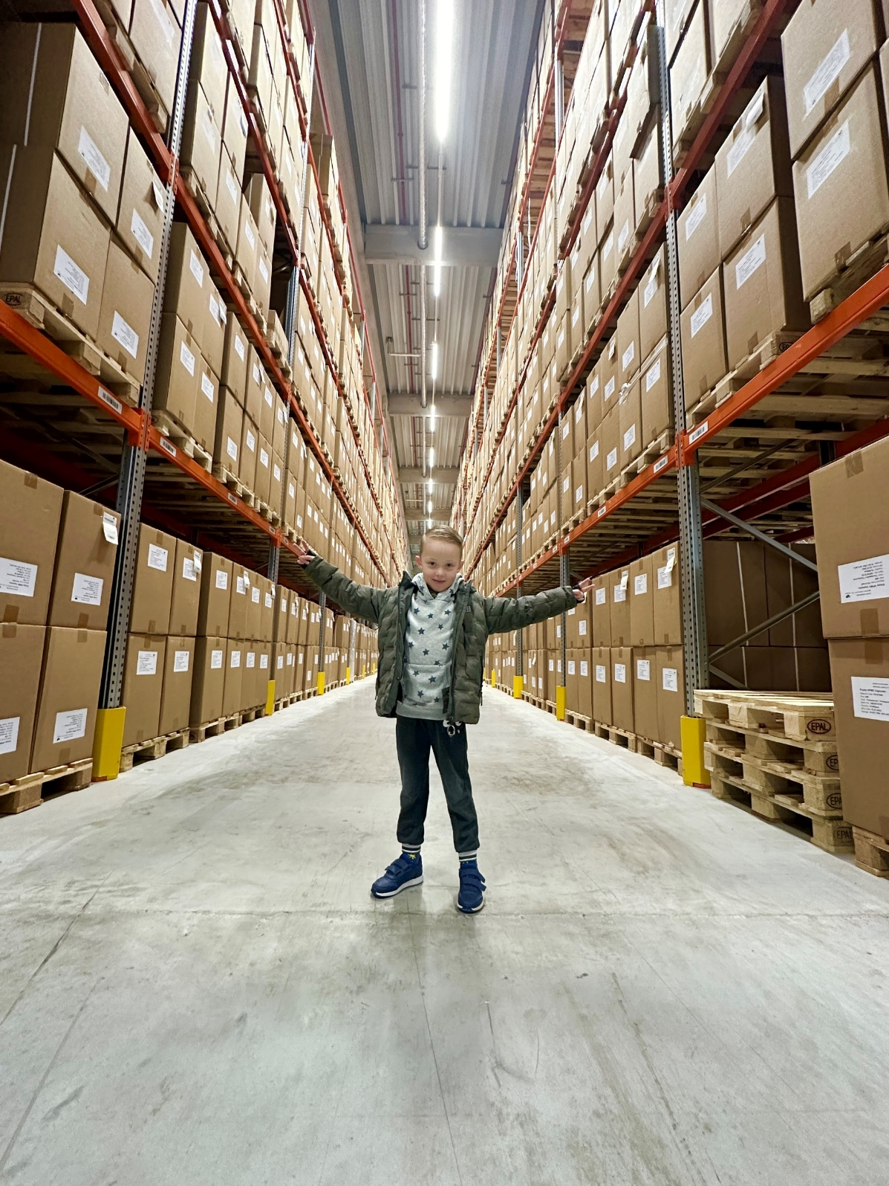

Slide 15
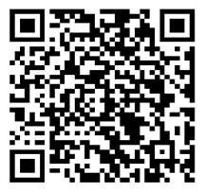
THANK YOU

